Slide 1
Mobile App Anatomy
In Depth Analysis of WAL and SHM Files
November 13, 2019 | James Eichbaum, MSAB

Slide 2



About the Presenter
James Eichbaum
Global Training Manager – MSAB, Inc.
17 Years Law Enforcement Experience
1 with Stockton Police Department – Reserve Police Officer
12 with the Modesto Police Department – Police Officer/Detective
4 with the Stanislaus County Sheriff’s Office – Deputy Sheriff/Detective
Assigned to Sacramento Valley High Tech Crime Task Force
TFO with Sacramento FBI Cyber Crime Task Force
Associates Degree in Computer Science
Associates Degree in Public Health & Safety
Bachelors Degree in Information Systems Security
HTCIA Case of the Year 2011
EnCE

Slide 3
Today’s Goals
To understand the relationship between
Write Ahead Log (WAL) Files
Shared Memory (SHM) Files
Database Files
The importance of analyzing all three files
When your mobile forensic tools do not support your target app
The manual investigation of apps to obtain evidentiary data
Analyzing the database alone could result in missed evidentiary data
incriminating or exculpatory
For validating your mobile forensic tools

Slide 4



Tools Used Today
HxD or Hex Workshop
https://mh-nexus.de/en/hxd/
http://www.bpsoft.com/downloads/
SQLite Expert Personal 5
http://www.sqliteexpert.com/download.html

Slide 5

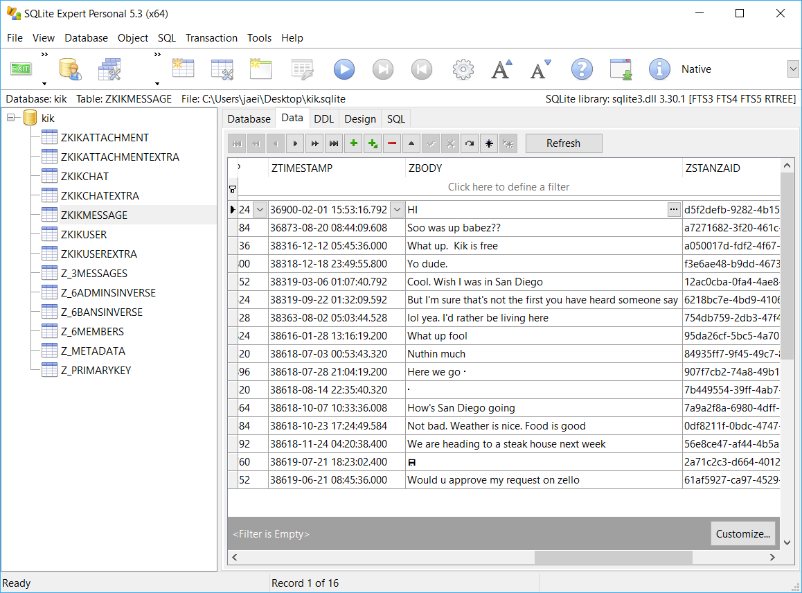
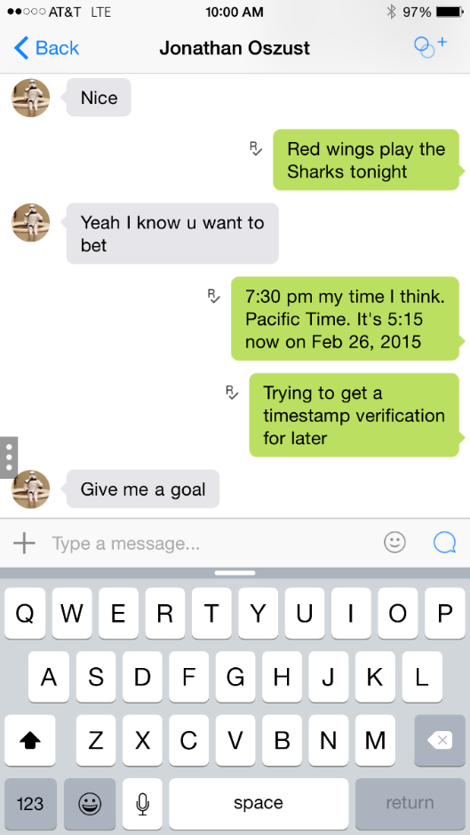
Where are the messages?
Copy kik.sqlite to the Desktop
Open kik.sqlite in SQLite Expert Personal or another database viewer
Select the ZKIKMESSAGE table and select the Data tab in the right window pane
Can you find the messages seen on the iDevice screen within the database?

Slide 6
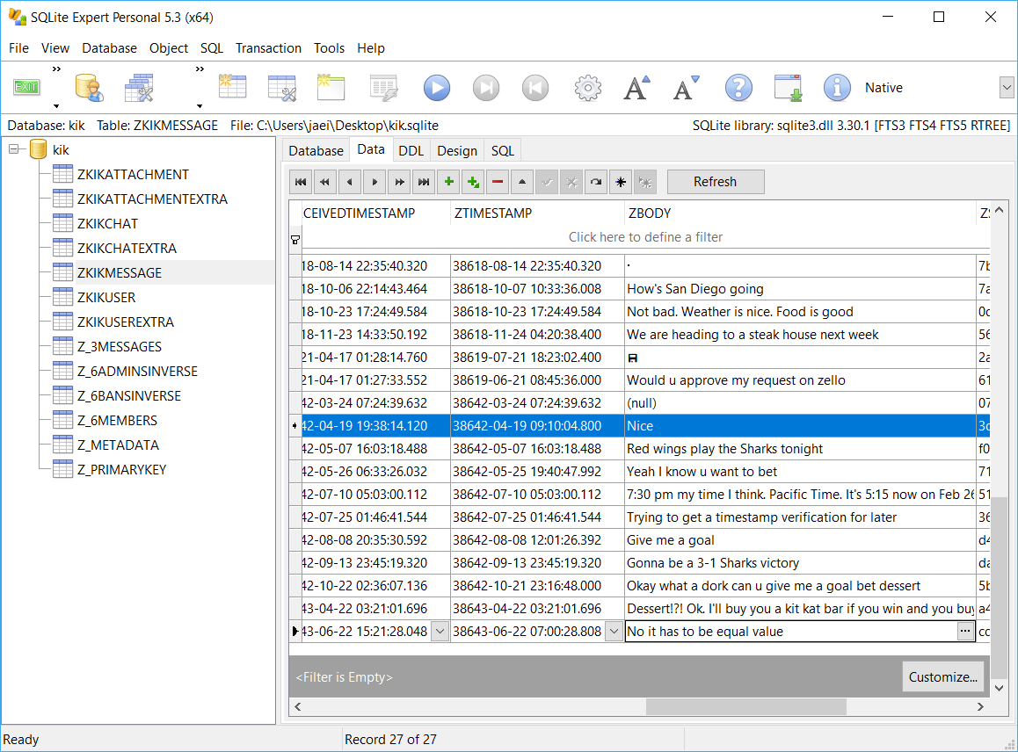
Here are the messages…
Close SQLite Expert Personal
Copy kik.sqlite-shm and kik.sqlite-wal to the Desktop
Notice the size of each file compared to the database
Open kik.sqlite in SQLite Expert Personal
Select the ZKIKMESSAGE table and select the Data tab in the right window pane

Slide 7
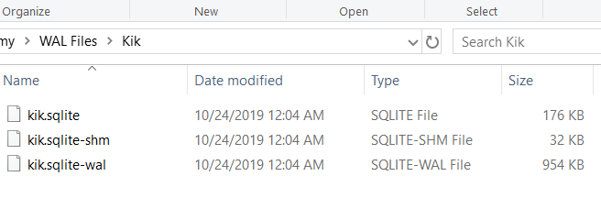
Where did our files go?
Close SQLite Expert Personal
Are the kik.sqlite-shm and kik.sqlite-wal files still on the Desktop?
What do you think happened to them?
What would have happened if only the database was extracted and analyzed?
Did the file sizes provide any hints as to what is happening?

Slide 8
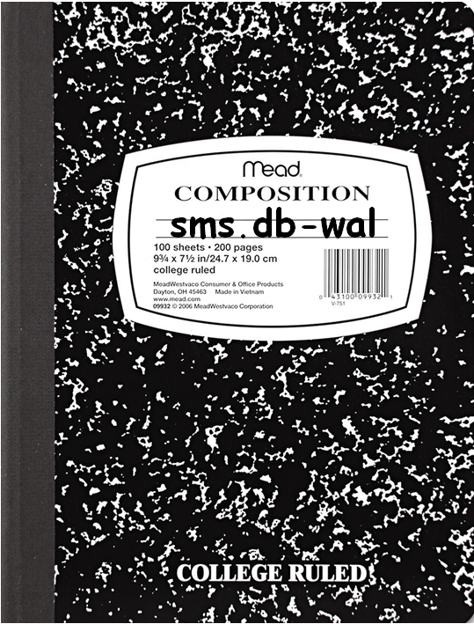


Three Files Working in Concert
WAL File
Data is initially written to this file first
Allows for increased speed and efficiency in database read/writes
The WAL file will continue to grow and maintain modifications to the database file
Data is eventually committed and written to the database file
SHM File
Keeps track of pages in the WAL file
Acts as a directory or index to where the most recent/current pages in the WAL are located
Database File
On commit, is comprised of the most recent pages from the WAL file
Notes:
All three files work together to maintain content in the actual database. Records are added and stored in the write ahead log before being transferred (committed) to the database file.
The shared memory file, SHM, is the index to the WAL file. The SHM file keeps track of all the pages within the WAL file. The file acts as a directory or index to where all the current pages are located within the WAL. Therefore, all three files are needed to create the final working database. The SHM file will identify which pages are current in the WAL file so that those pages are the ones that get committed and written to the actual database.

Slide 9
What is a Commit?
A commit transfers the most recent pages in the WAL file to the database
When does that happen?
When the WAL reaches 1000 pages
When a record forcing a commit is added to the database
When the database is opened in a database viewer with the SHM and WAL files present
This happened when we opened kik.sqlite in SQLite Expert Personal
To obtain the most recent version of the database, we should export and employ the WAL

Slide 10
The WAL File – A Visual Example

Slide 11
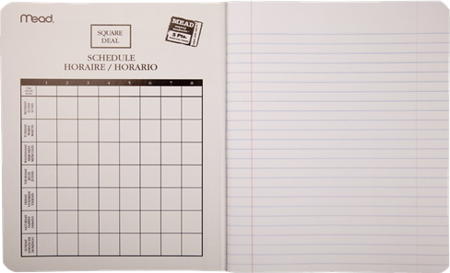

Page 1
Page 2
Page 3
SQLite format 3 – Main Header
0 changes
3 pages
Table Structures
Leaf Page
No Records Yet
Leaf Page
No Records Yet
sms.db-wal
Hello
Notes:
A person just bought their new iPhone. They have just begun to send text messages to their friends. Their initial text messages are not immediately written to the sms.db database file. Instead, the messages are written to the sms.db-wal file. You can think of the WAL file as a small book.
The WAL contains three pages. Page 1 is page 1 of the database. Page one contains the database header and 2 tables. Those tables point to their leaf pages, pages 2 and 3 of the database respectfully.

Slide 12
Page 1
Page 2
Page 3
SQLite format 3 – Main Header
0 changes
3 pages
Table Structures
Leaf Page
No Records Yet
Leaf Page
No Records Yet
sms.db-wal
Page 1
Page 3
SQLite format 3 – Main Header
1 change
3 pages
Table Structures
Leaf Page
Record 1 (Hello)
Hello
Notes:
The new user, Johnny, sends a text message to his friend, Tom. The outgoing message reads, “Hello” That message is initially written to the WAL file, still leaving the database empty.
The new record was added to page three, the leaf tree page belonging to table 2.

Slide 13
Page 1
Page 2
Page 3
SQLite format 3 – Main Header
0 changes
3 pages
Table Structures
Leaf Page
No Records Yet
Leaf Page
No Records Yet
sms.db-wal
Page 1
Page 3
Page 1
Page 3
SQLite format 3 – Main Header
1 change
3 pages
Table Structures
Leaf Page
Record 1 (Hello)
SQLite format 3 – Main Header
2 changes
3 pages
Table Structures
Leaf Page
Record 2 (Hi)
Record 1 (Hello)
Hi
Hello
Notes:
Tom replied to Johnny saying, “Hi” Page 3 of the WAL file seems to have room for additional records, but page 3 in the WAL file cannot be modified. Instead, a new page is created that will hold both text messages. A new page will also be created to store page 1 since the database has been updated.

Slide 14
Page 1
Page 2
Page 3
SQLite format 3 – Main Header
0 changes
3 pages
Table Structures
Leaf Page
No Records Yet
Leaf Page
No Records Yet
sms.db-wal
Page 1
Page 3
Page 1
Page 3
SQLite format 3 – Main Header
1 change
3 pages
Table Structures
Leaf Page
Record 1 (Hello)
SQLite format 3 – Main Header
2 changes
3 pages
Table Structures
Leaf Page
Record 2 (Hi)
Record 1 (Hello)
Hi
Hello
Notes:
The WAL file continues to grow as records are added and/or deleted.
If there was a commit to occur, the most recent pages will be committed to the database. In this case, the third instance of page 1, the first instance of page 2 (since there were never any records added for table 1’s records), and the third instance of page 3.
The SHM file will determine which pages are the most current pages to be committed to the database from the WAL file

Slide 15
sms.db
sms.db-shm

Slide 16
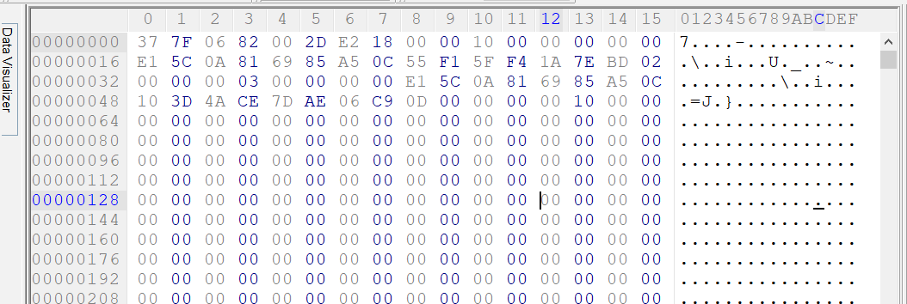
The WAL File - Header
32 byte header
Header offset 8
4 bytes indicate the size of the pages in the database (read big Endian)
i.e. 0x/00001000 equates to 4096 bytes
Offset | Length | Description
0 | 4 | Magic #
4 | 4 | File Format Version
8 | 4 | Database Page Size
12 | 4 | Checkpoint Seq Number
16 | 4 | Salt 1
20 | 4 | Salt 2
24 | 4 | Checksum 1
28 | 4 | Checksum 2
Notes:
The first four bytes of the WAL header is the magic, or the file identification. There are two options; if the magic number is 0x377F0683, then 32-bit integers found in the WAL file are read as Big-Endian integers. If the magic is 0x377F0682, then 32-bit integers found in the WAL file are read as Little-Endian integers.
The following four bytes indicate the file format version of SQLite. Latest database versions will be 3007000.
The four bytes at offset eight indicate the size of each page in the database.
The four bytes at offset 12 is the checkpoint sequence number (how many check points have occurred). If the value is zero, then there has not been a checkpoint and no records have been committed to the database yet.
The four bytes at offset 16 and four bytes at offset 20 are random salt values that increment whenever a checkpoint has been made to commit records to the database file.
The remaining four bytes at offset 24 and at offset 28 are the first half and second half checksum values for the WAL header.

Slide 17
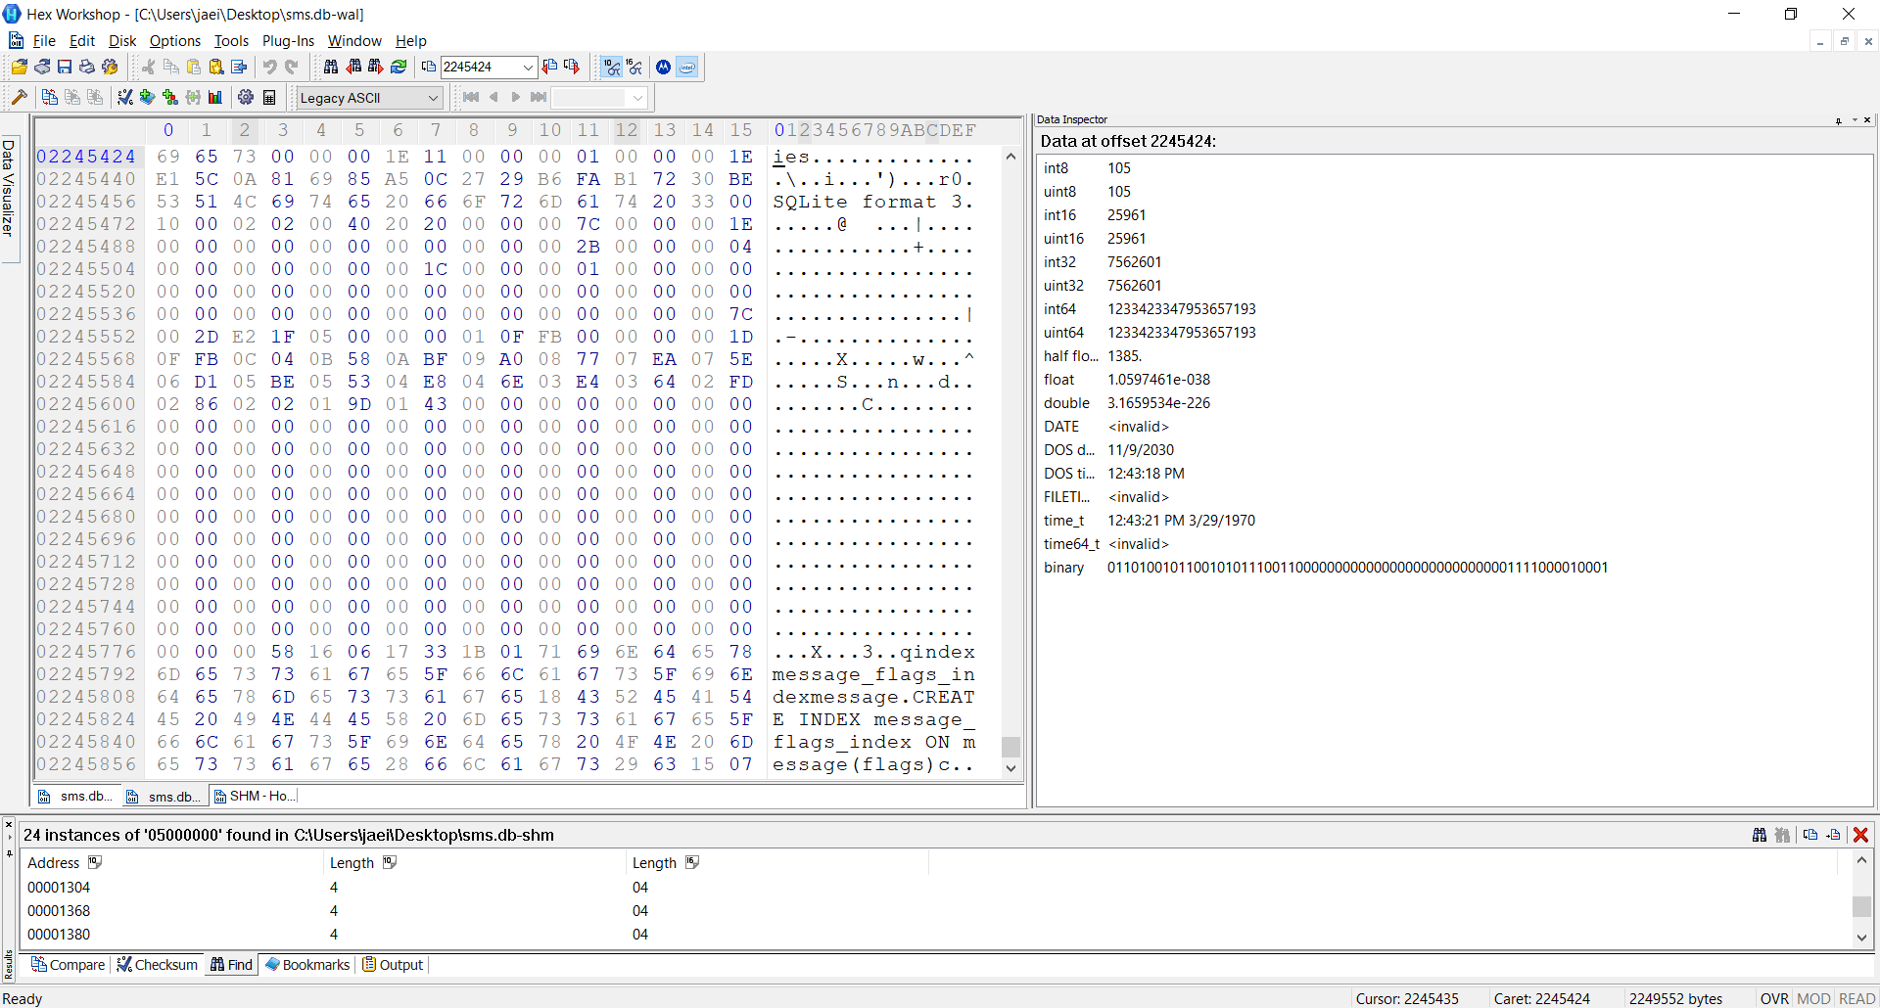
What do WAL Pages Look Like?
Exactly like the database pages they may eventually become
Except they are preceded by a 24 byte frame header
Offset 0 for 4 bytes provides the page number
Offset | Length | Description
0 | 4 | Page Number
4 | 4 | Database size in pages
8 | 4 | Salt 1 – From WAL Header
12 | 4 | Salt 2 – From WAL Header
16 | 4 | Checksum 1
20 | 4 | Checksum 2
Page 1 of the Database
Notes:
The first four bytes of the header indicate what database page number is to follow. The second four bytes indicates how many pages the database will hold if there was a checkpoint or commit. In this case, there would be 30 pages in this database. Each page is 4,096 bytes in length. The database would be 122,880 bytes in length once all the latest pages are committed.
Both Salt values in this frame header match the Salt values found in the main WAL header. The WAL file will only commit pages to the database that are the latest and have the same Salt value found in the main header.
The database will build itself based on the latest versions of each page in the WAL file with the same salt value found in the WAL header. Once a commit is made, the salt in the WAL header can change and new pages may be created at the beginning of the WAL file. For the next commit, the WAL will look for pages with the matching salt values and then the last instance of the page within the WAL file. So there could be a page 7, for instance, found at the end of the WAL file. But the salt values found in page 7’s frame header may not match the salt values found in the WAL header. The WAL would ignore this instance of page 7 and use the instance before it that had the matching salt values.

Slide 18
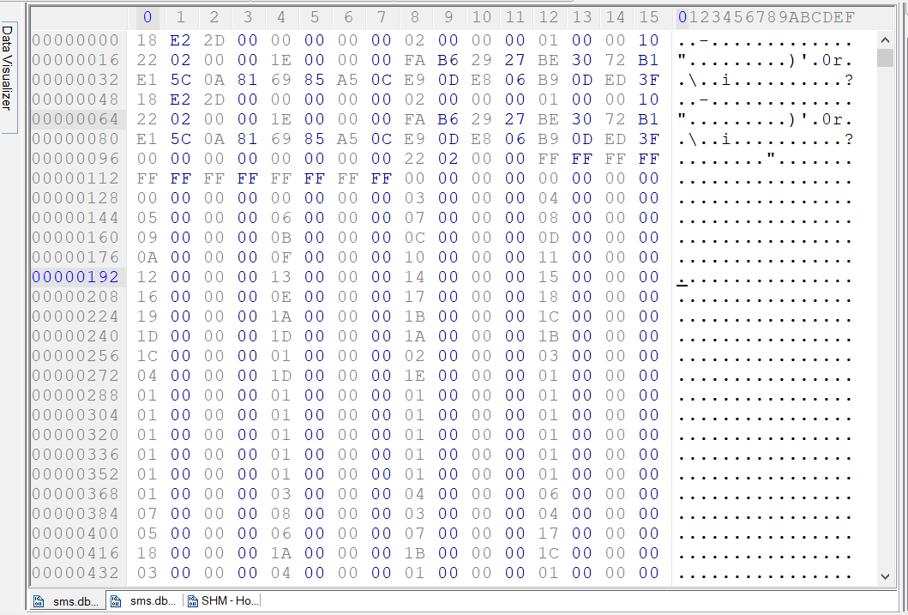
The SHM File
An Index or Directory used to look up and find the most recent versions of each page in the WAL to be written to the database
With matching SALT values
136 byte file header
Followed by pointers to each page in the WAL file
Each as a 4 byte little Endian value
Notes:
How do we know where to find page 3 or page 5 in the WAL file? Or every instance of those pages so we can figure out which one is the most current page that would be written to the actual database?
The shared memory file acts as an index or directory, providing the offset to each page.

Slide 19
Using the SHM File to Find Pages in the WAL
O = Offset to the page number in the SHM file
S = Page size indicated by the WAL file header
X = Offset to the start of the page within the WAL file
Each page in the WAL file is made up of S number of bytes plus the 24 byte frame header
The SHM header is 136 bytes. We need to remove that 136 bytes by subtracting it from O
The WAL header (32 Bytes) plus the WAL page header (24 bytes) = 56 bytes
Places us at the start of the actual page that would end up in the database
X = (S+24) * ((O – 136) / 4) + 56
Notes:
where in the wal file is page 4
its at offset 560 in the shm
file
the wall file made up of pages
this case each page is 4096 + the 24 byte frame header. gets us the total accounted for bytes for every page
how many pages until the start of the page we are looking at?
we have to account for the wal header.... thats where we will be starting.
the shm header is 136
whatever the offset in the shm, subtract the header of the shm from that offset - (560 - 136) is 424
then divide by 4
Why? Take the pages themselves and place them in a hex editor start at offset 136 and copy and paste 424
This isolates the pages. Each page is referenced by 4 btyes. How many pages are referernces. Which instance our we interested in. this one happens to be the 106th one. We start at zero.
Verify by using the first page refference... 03.. which is at offset 136. 136 - 136 = 0 divide by 4 is 0. Reference number 0
56 is the 32 byte wal header and the 24 byte header of the current page we want..... placing us at the start of the page.

Slide 20
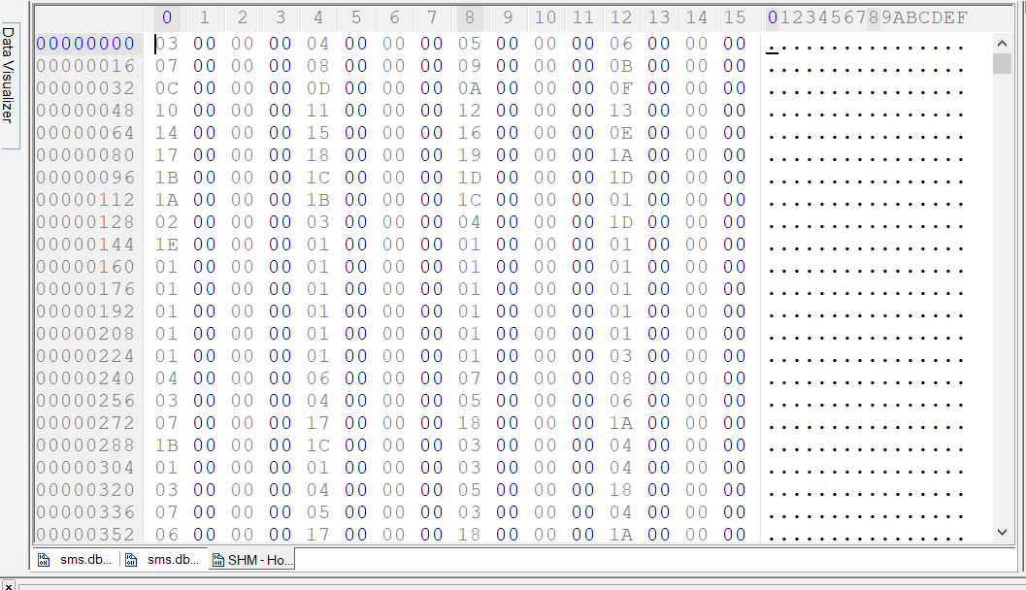
SHM – Without the Header
Offset / 4
First instance of Page 3
Offset = 0
0/4 = 0
First instance of Page 4
Offset = 4
4/4 = 1
First instance of Page 5
Offset = 8
8/4 = 2
First instance of Page 6
Offset = 12
12/4 = 3
List_of_Pages = [3, 4, 5, 6]
0 1 2 3

Slide 21
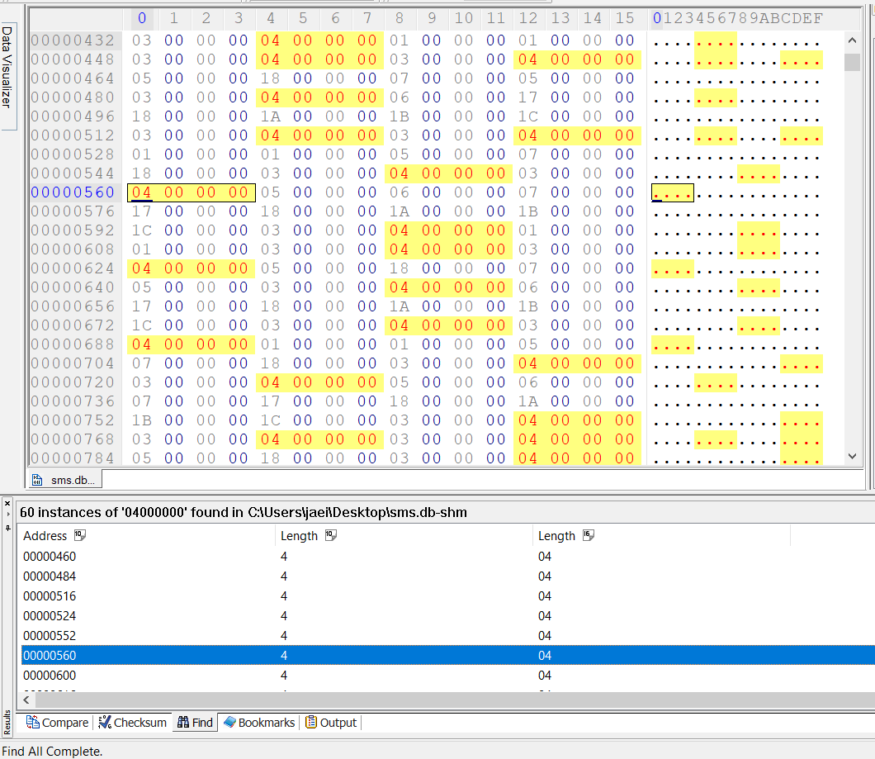
Locate Page 4 in the WAL
O = 560 (Index position 106 in the WAL file)
S = 4096 (From WAL header)
X = (S+24) * ((O – 136) / 4) + 56
X = (4096 + 24) * ((560 – 136) / 4) + 56
X = 4120 * (424/4) + 56
X = 4120 * 106 + 56
X = 436730 + 56
X = 436776

Slide 22
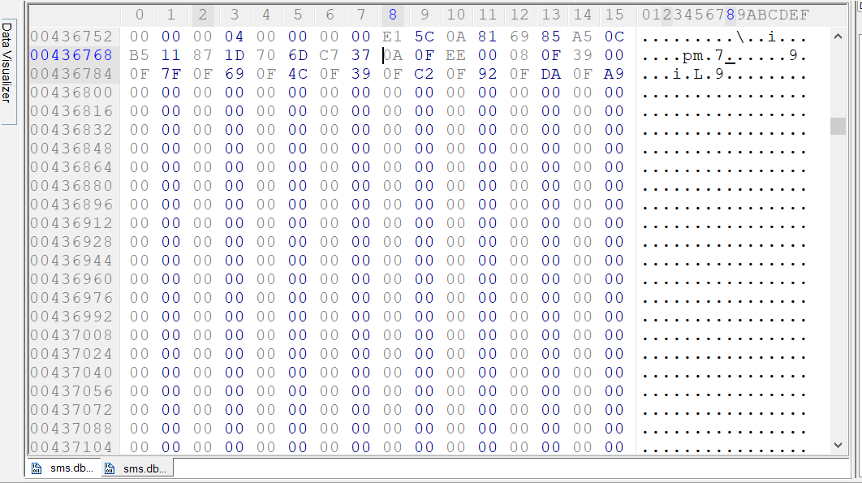
Locate Page 4 in the WAL (Go to 436776)
Takes us to 0x0A
Start of page 4
Page Type
Leaf Index B-Tree
24 byte frame header
Offset 0 for 4 bytes
Page 4
4096 byte page
Page 4 (4096 Bytes)

Slide 23
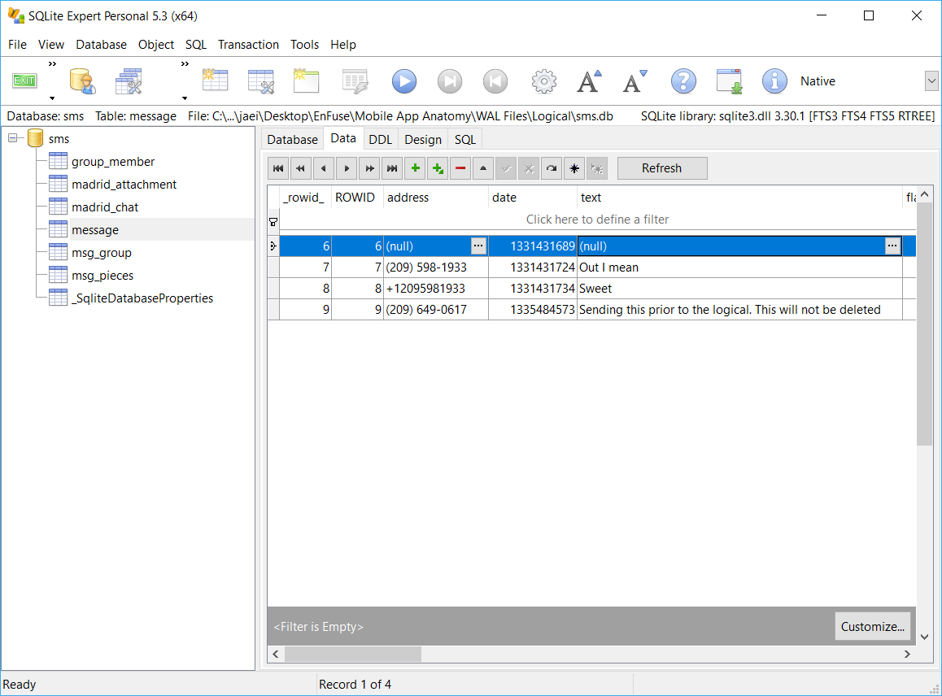
Why do we care?
Open sms.db found in the Logical folder in SQLite Expert Personal
Select the message table and select the Data tab in the right window pane
Note the messages that are currently found in the database

Slide 24
An Example of the Importance of the WAL File
Close SQLite Expert Personal
Copy sms.db, sms.db-shm, and sms.db-wal from the Physical folder to the Desktop
Overwrite if asked
Are there any hints from the file sizes as to the potential for additional records found in the WAL?
Open sms.db in SQLite Expert Personal
Select the message table and select Data in the right window pane
Are there any new messages?
Close SQLite Expert Personal
Copy sms.db, sms.db-shm, and sms.db-wal from the Physical folder to the Desktop
Overwrite if asked

Slide 25
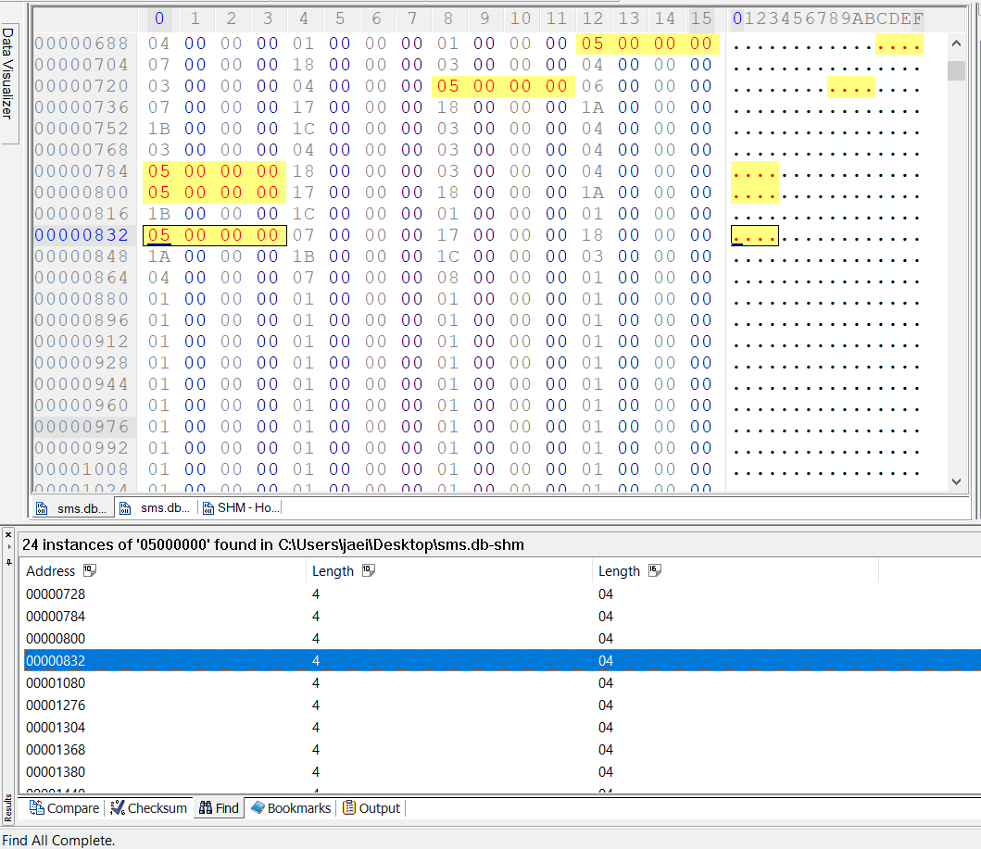
Page 5 in the WAL File
Open the SHM file in a hex editor
HxD or Hex Workshop
Calculate the 13th instance of page 5 in the WAL
Offset = 832
Calculate the last instance of page 5 in the WAL
Offset = 2216
Open the WAL file in a hex editor
GoTo both instances of page 5
What are the differences between the pages?
X = (S+24) * ((O – 136) / 4) + 56

Slide 26
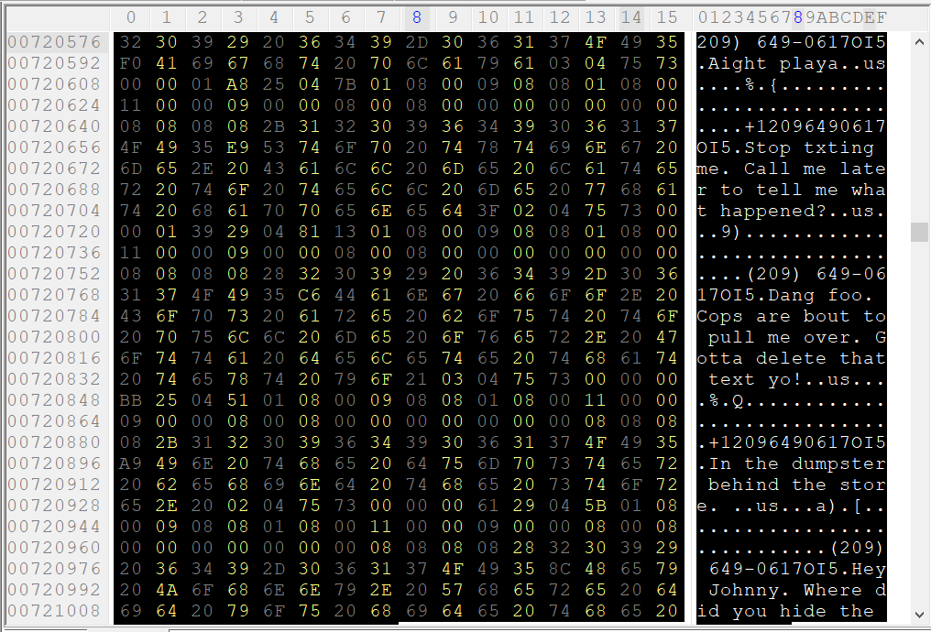
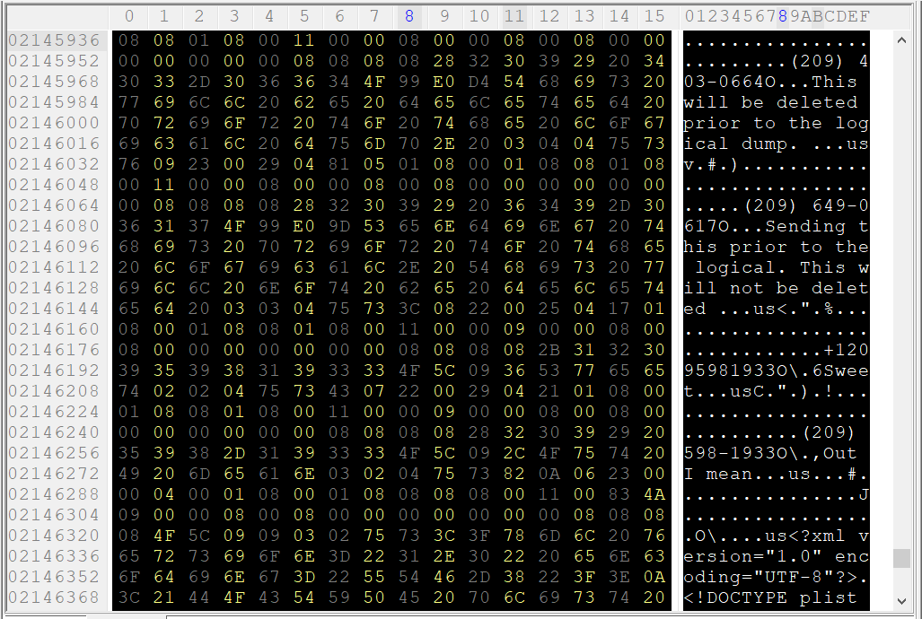
Page 5 vs Page 5
Would we find messages related to a gun and where it was discarded in the actual database?
Why or Why not?

Slide 27
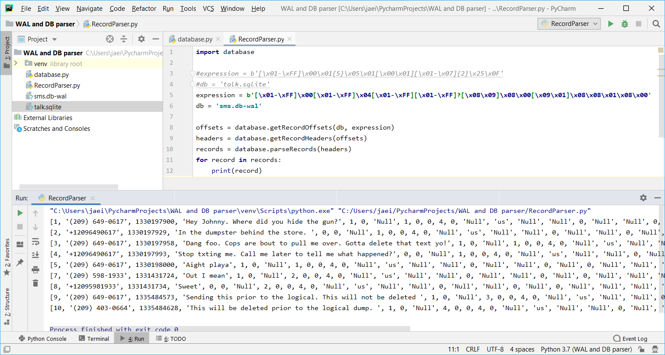
Using Python to Parse Records in the WAL

Slide 28
Thank you
twitter.com/opentext
linkedin.com/company/opentext
opentext.com

